Slide 1

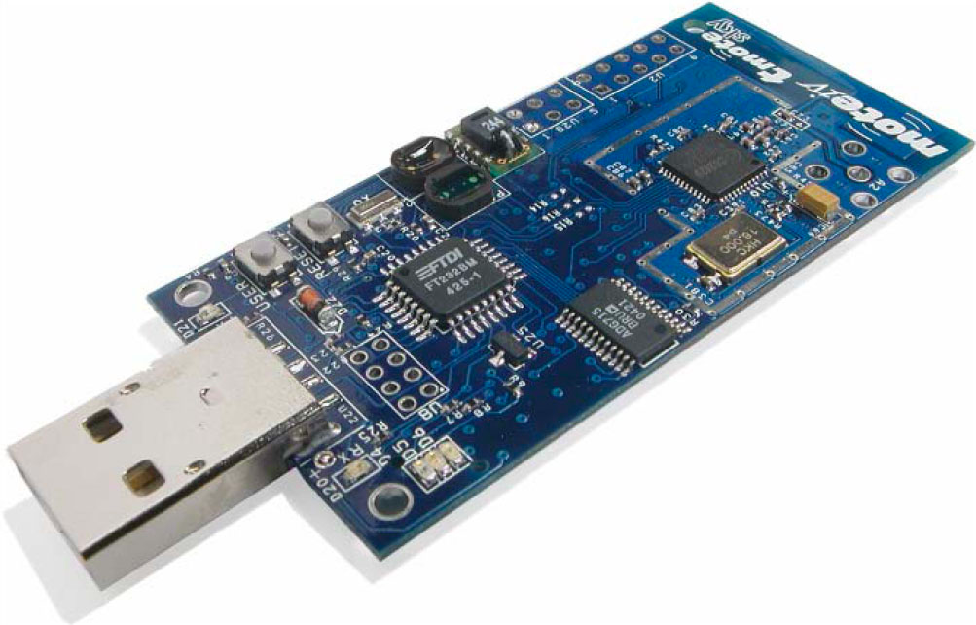
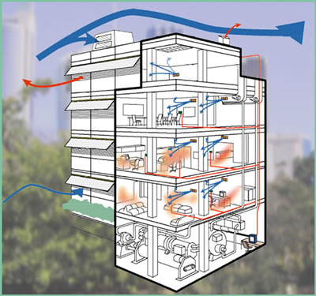
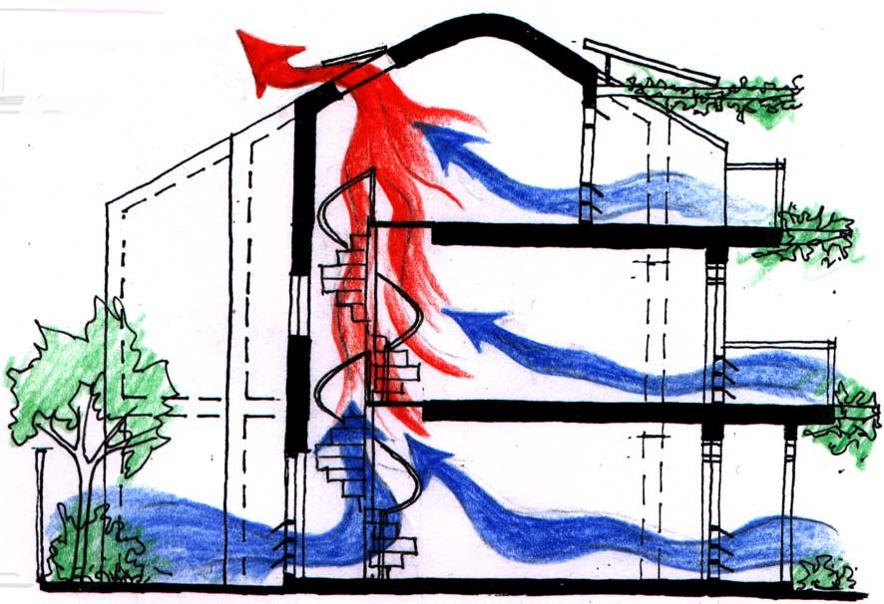

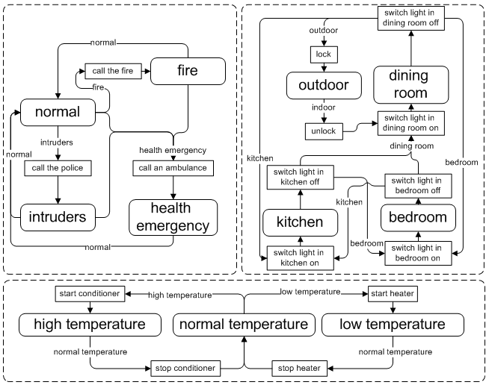


Towards Context-Oriented Programming for Wireless Sensor Networks
Mikhail Afanasov, Luca Mottola
Politecnico di Milano (Italy)
Contact email: thiemo@sics.se
Easy-way programming for Wireless Sensor Networks
Smart Home example
ConesC way
UBICOMP13 – Zurich (Switzerland), September 8th-12th

